Slide 1
Gary Jugert, director

Slide 2
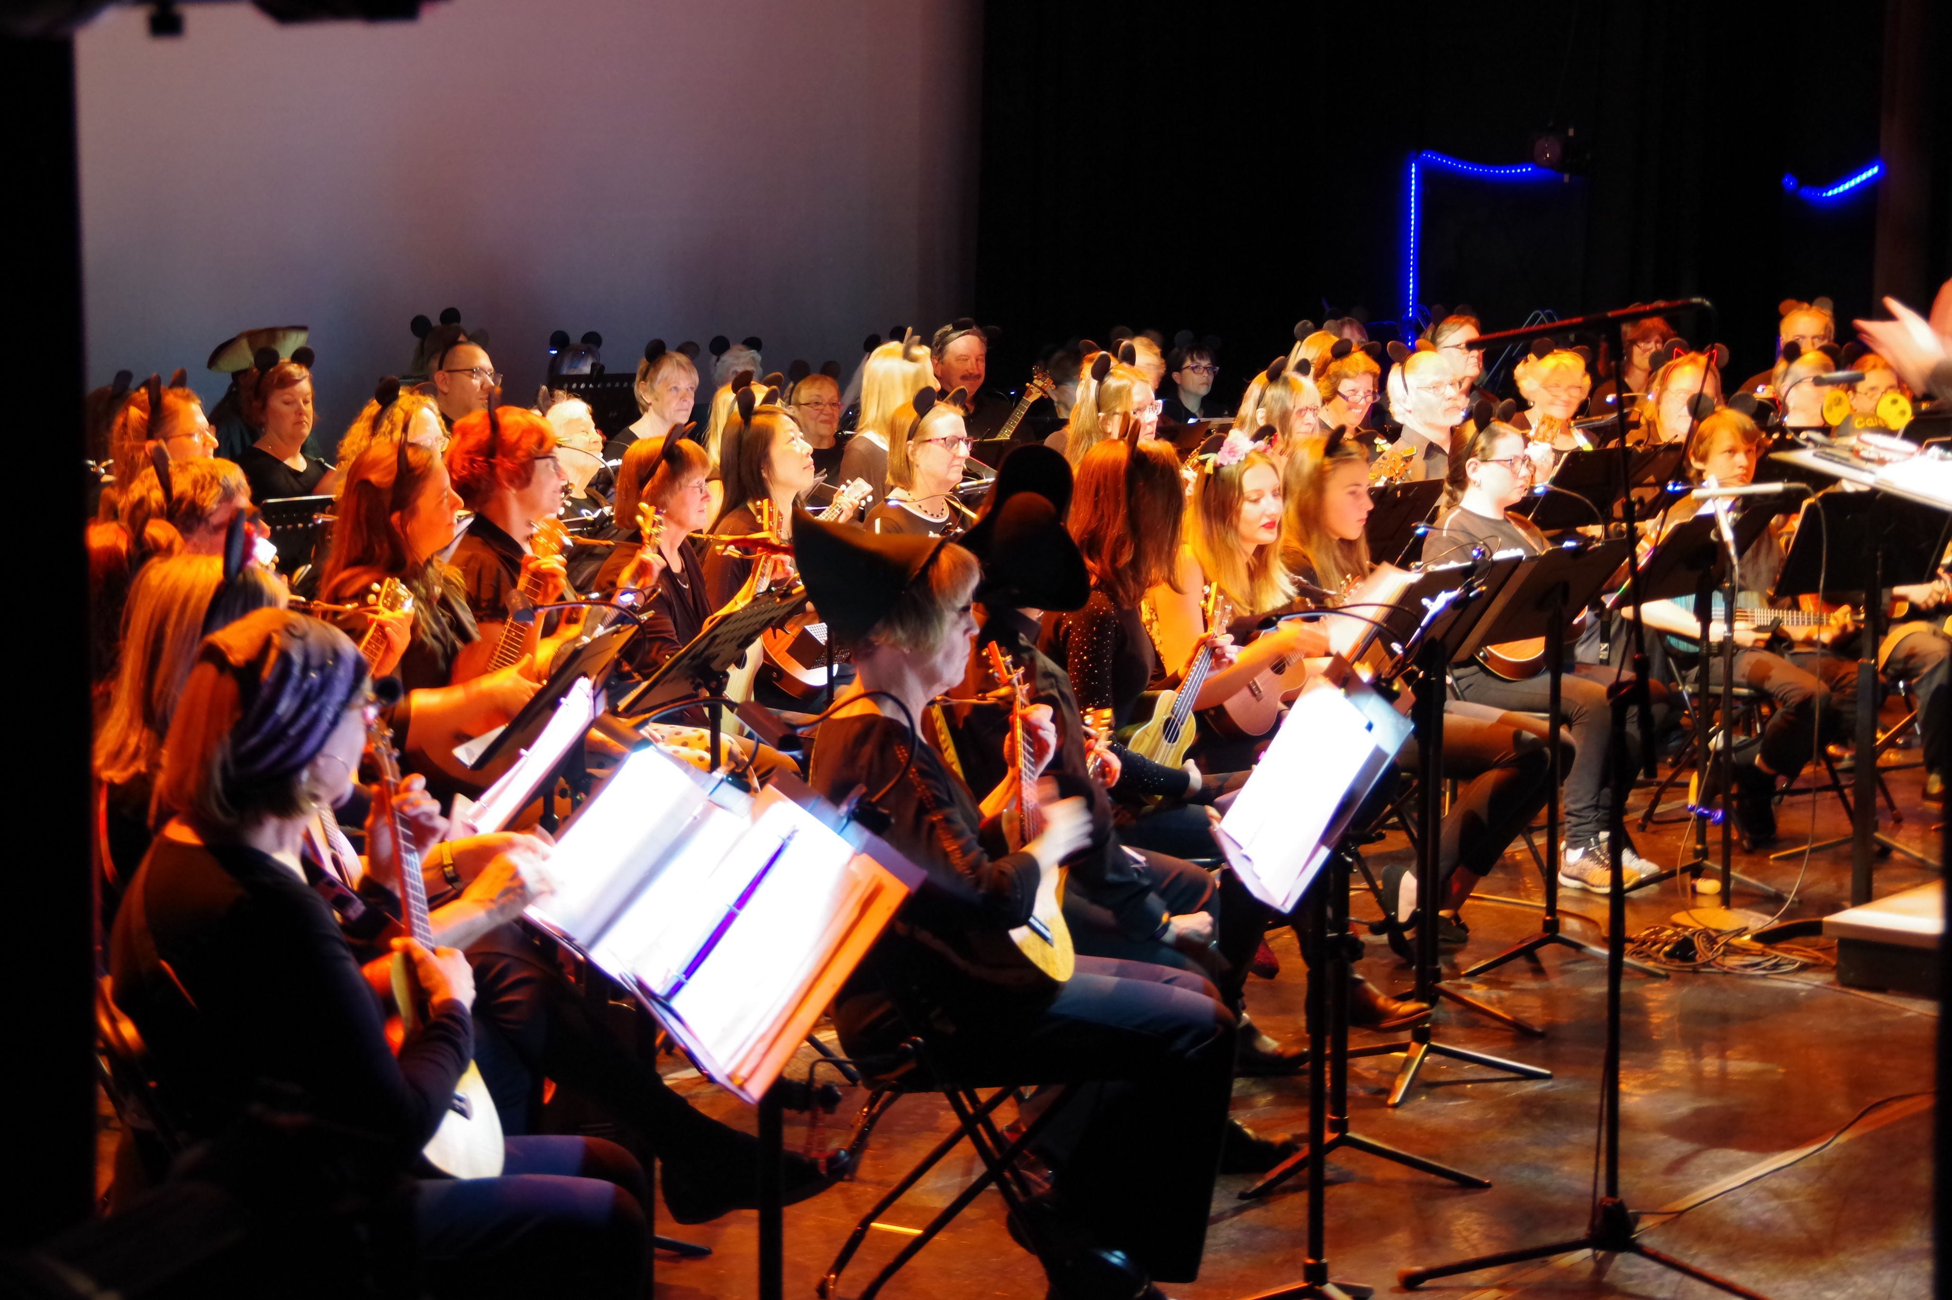
Basic Philosophies of RMUO
Treat this instrument like any other “real” instrument.

Slide 3
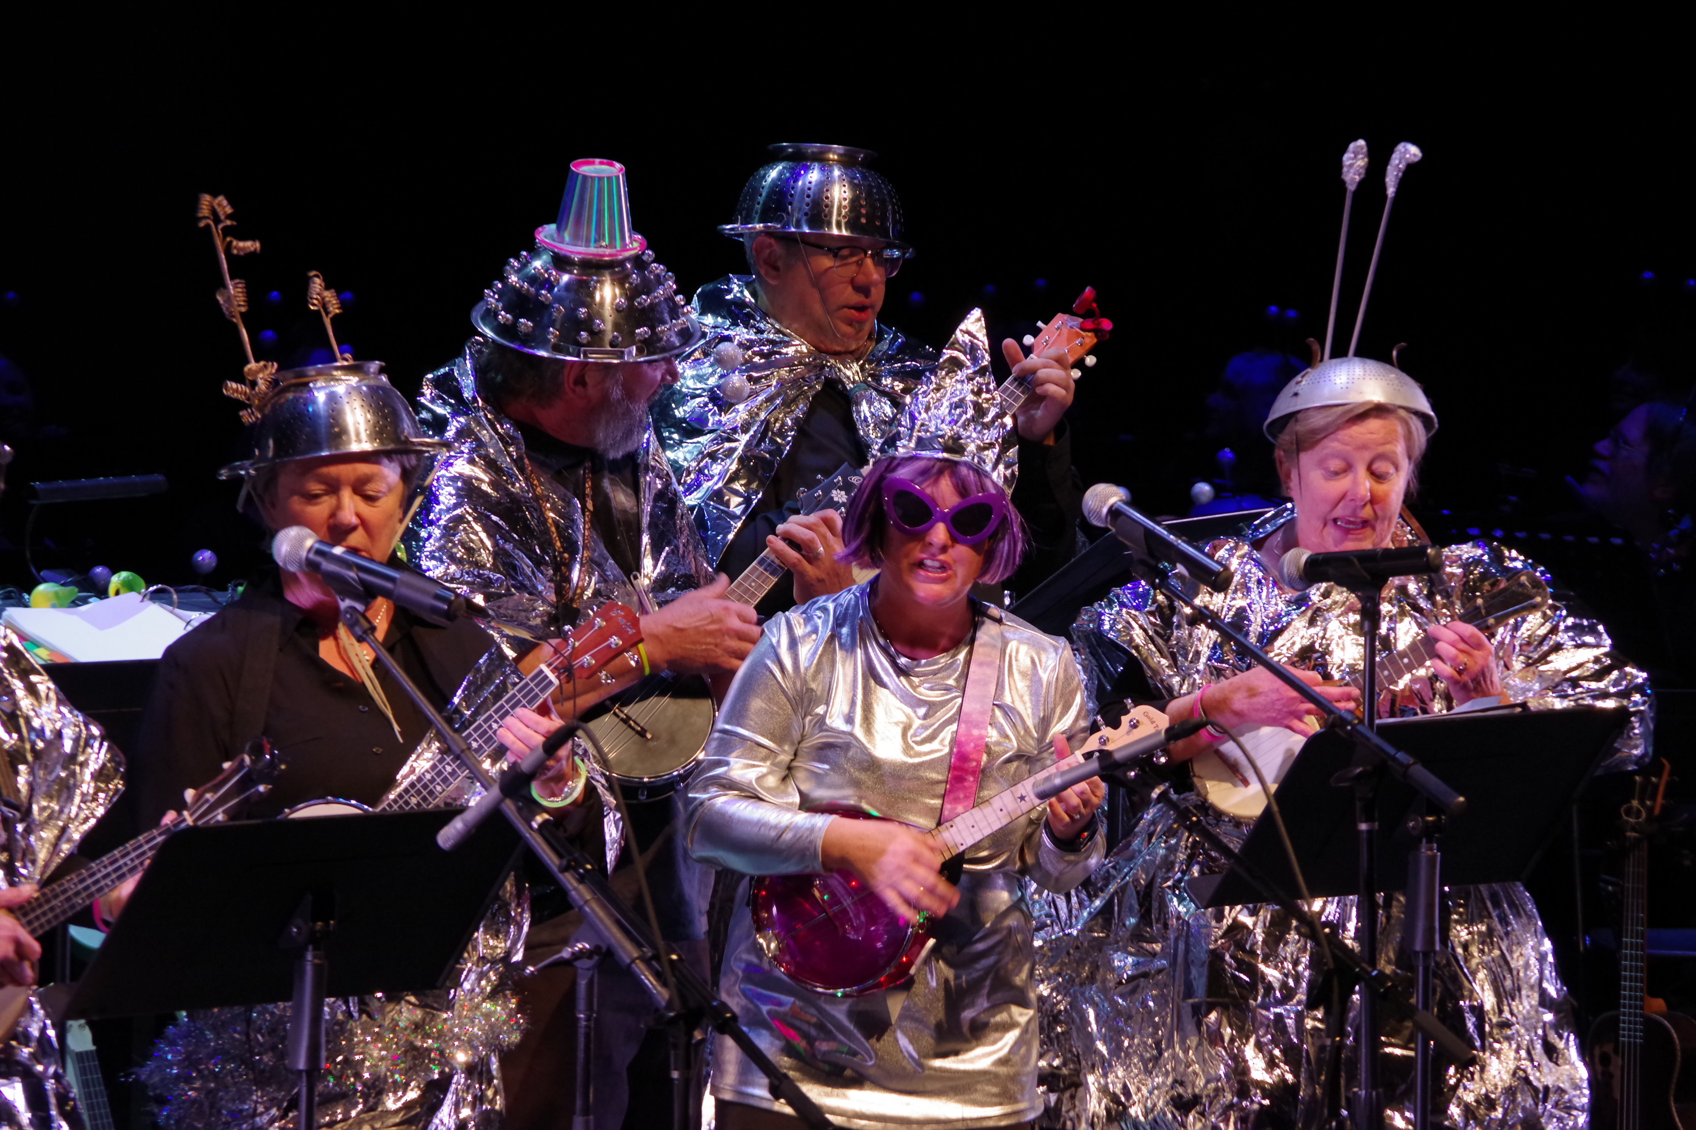
Basic Philosophies of RMUO
Perform with ukuleles in every possible way.

Slide 4
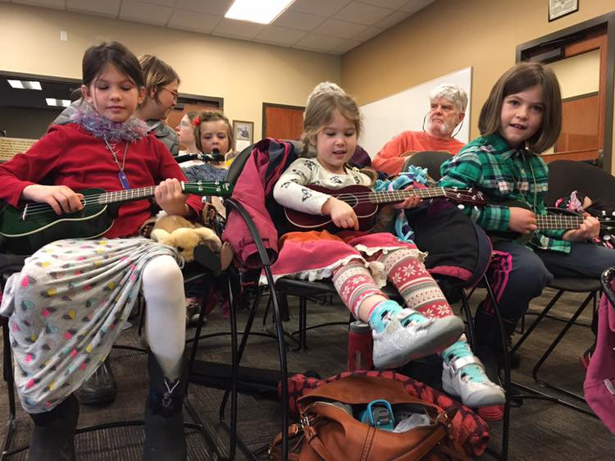
Basic Philosophies of RMUO
Leave the door open and let anybody into rehearsals wanting to become a better musician and then support them with quality teaching and materials. No auditions!

Slide 5
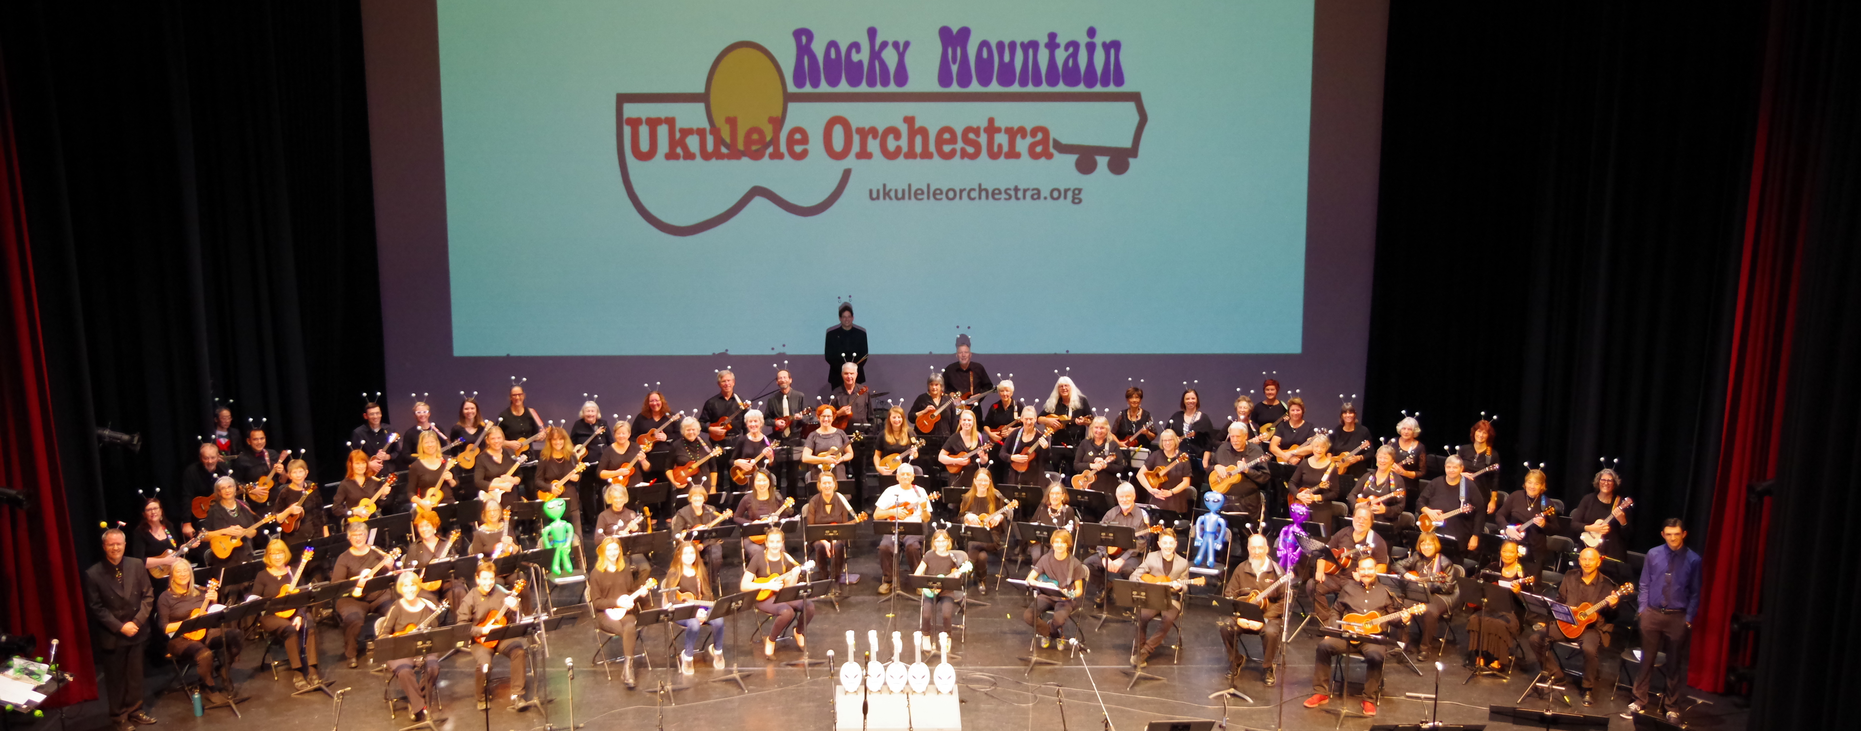
Basic Philosophies of RMUO
Play ukulele for life in a positive environment.

Slide 6
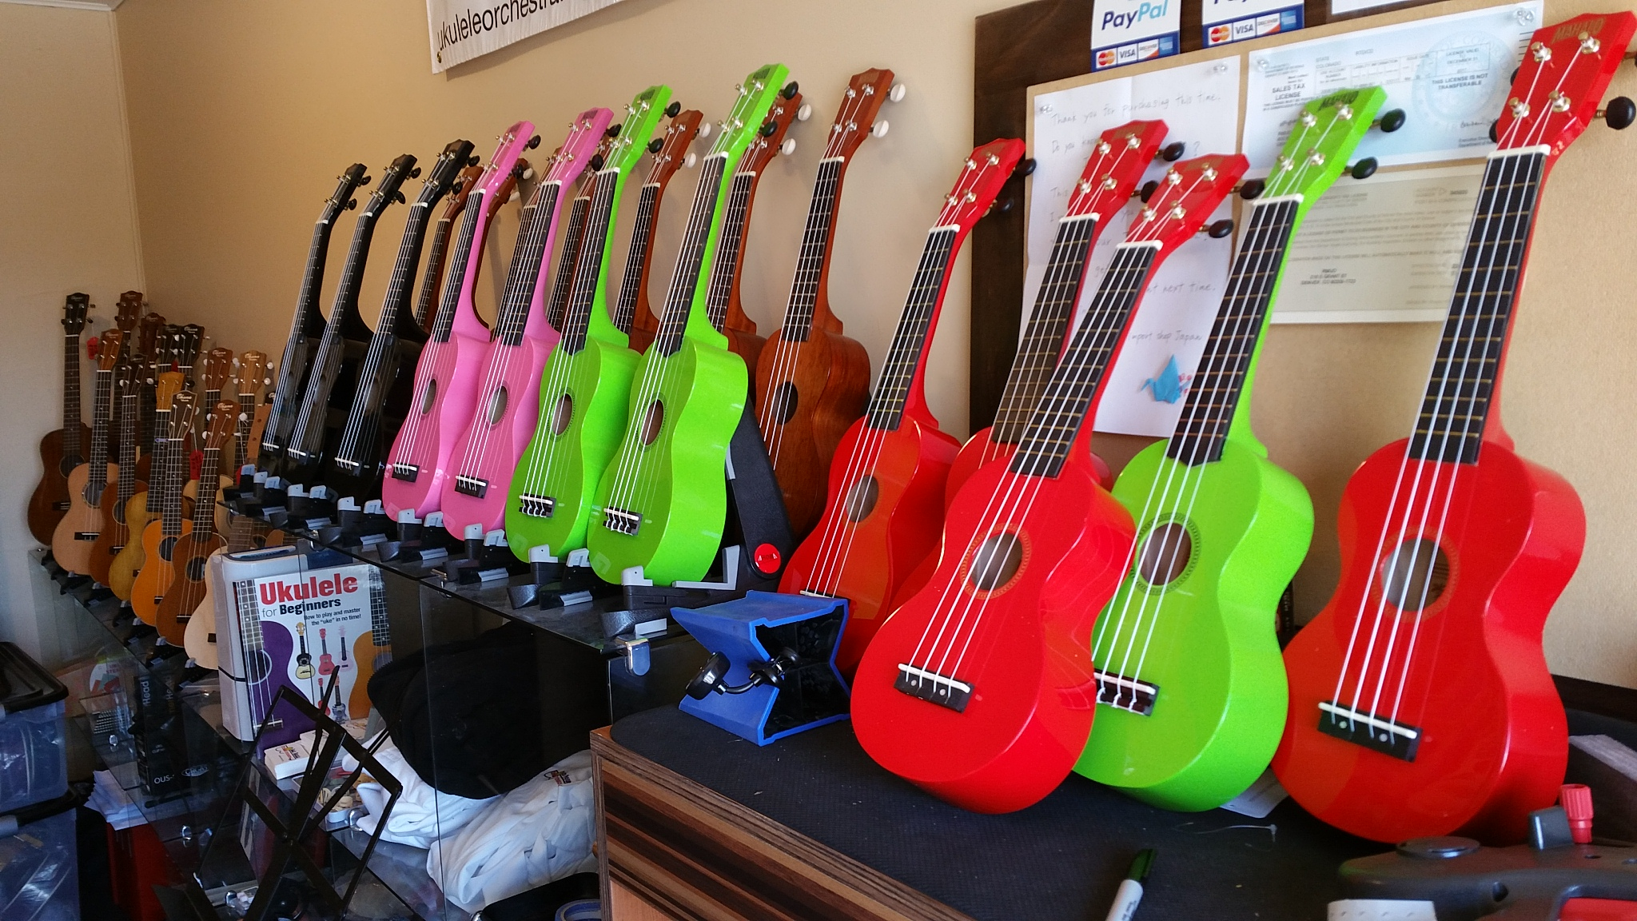
Services Available from RMUO
Instrument purchases competitively priced and properly supported with setup, delivery and repairs.

Slide 7
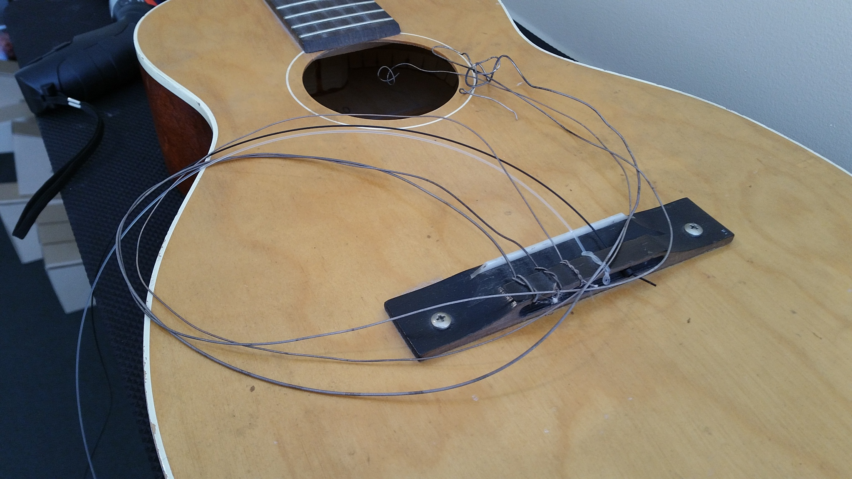
Services Available from RMUO
Stringed instrument set-ups and repairs.

Slide 8
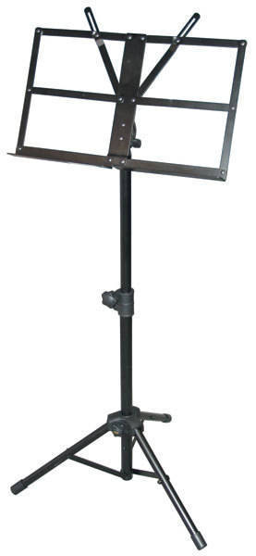
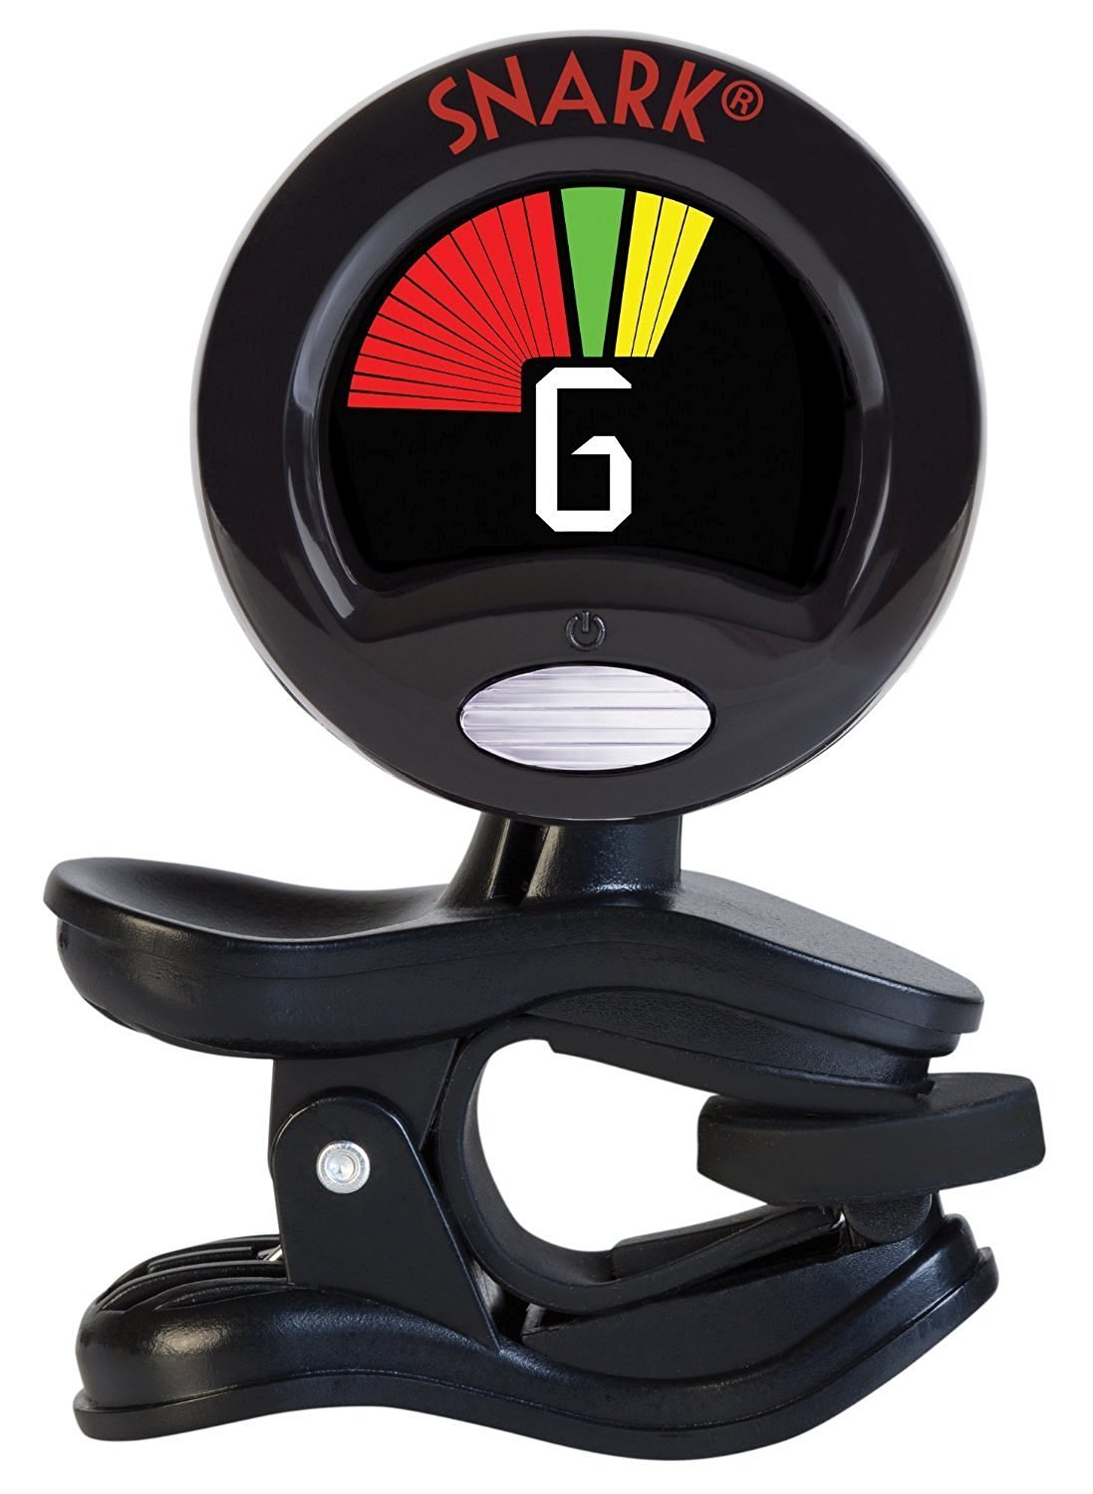
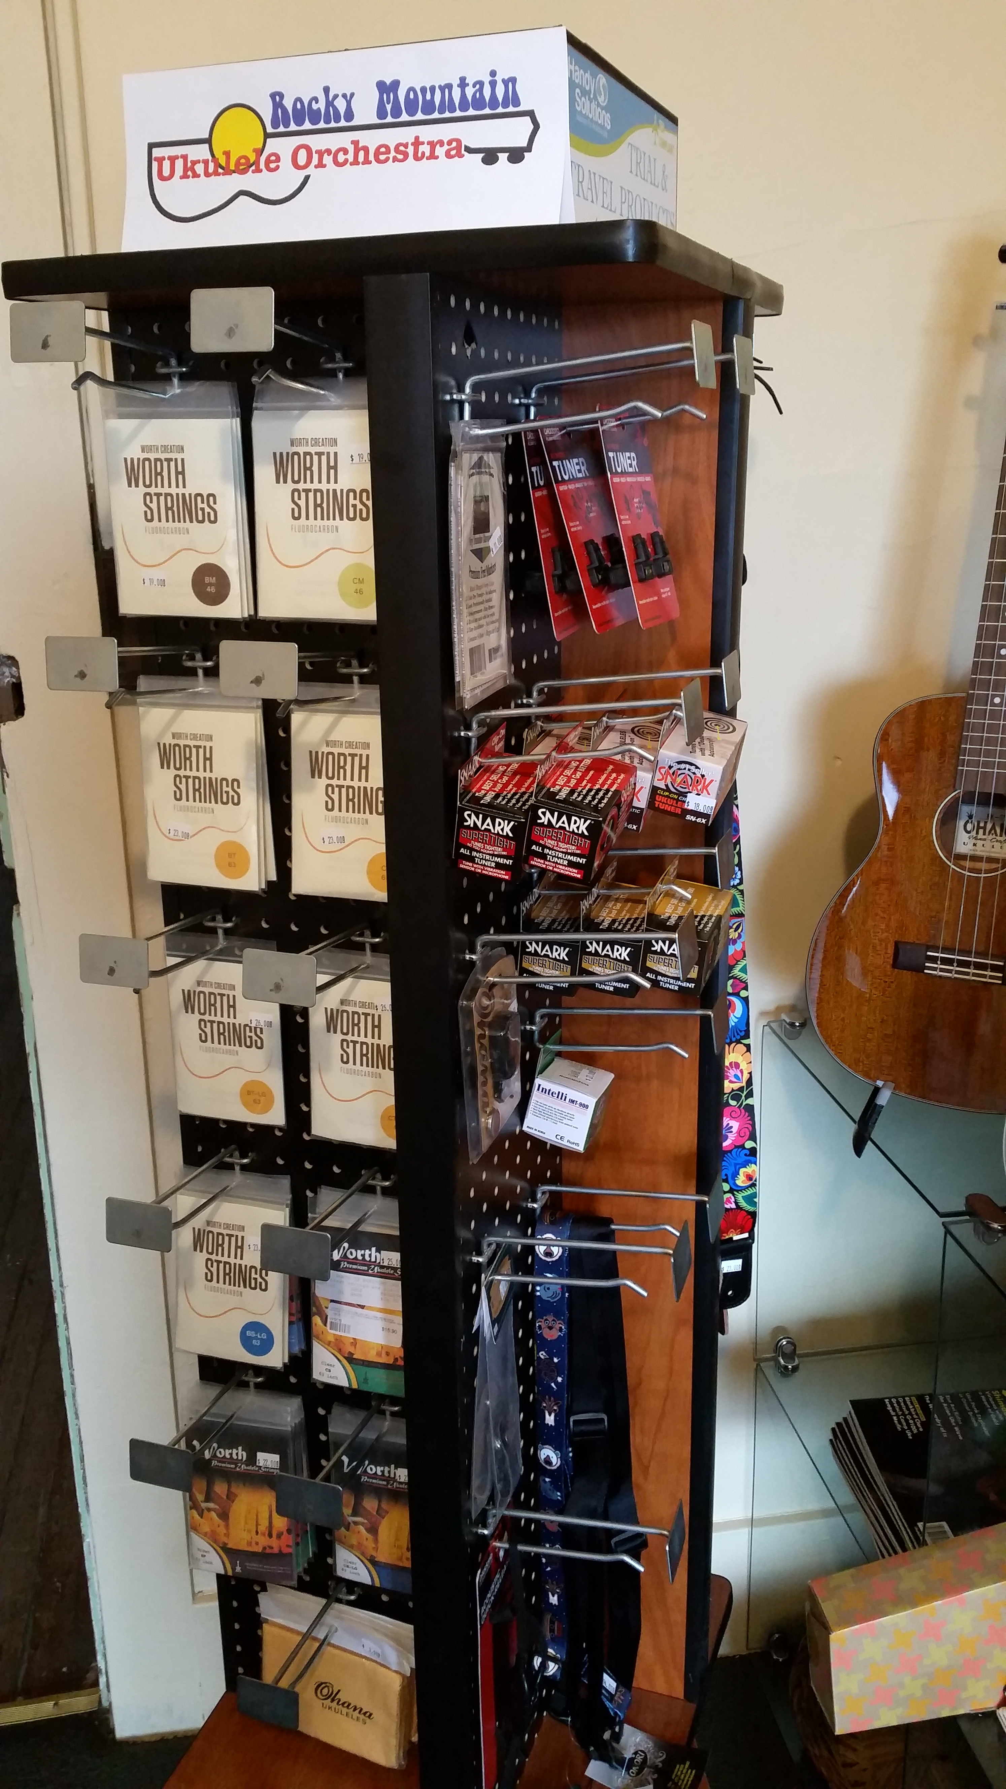
Services Available from RMUO
Complete line of accessories to support musicians.

Slide 9
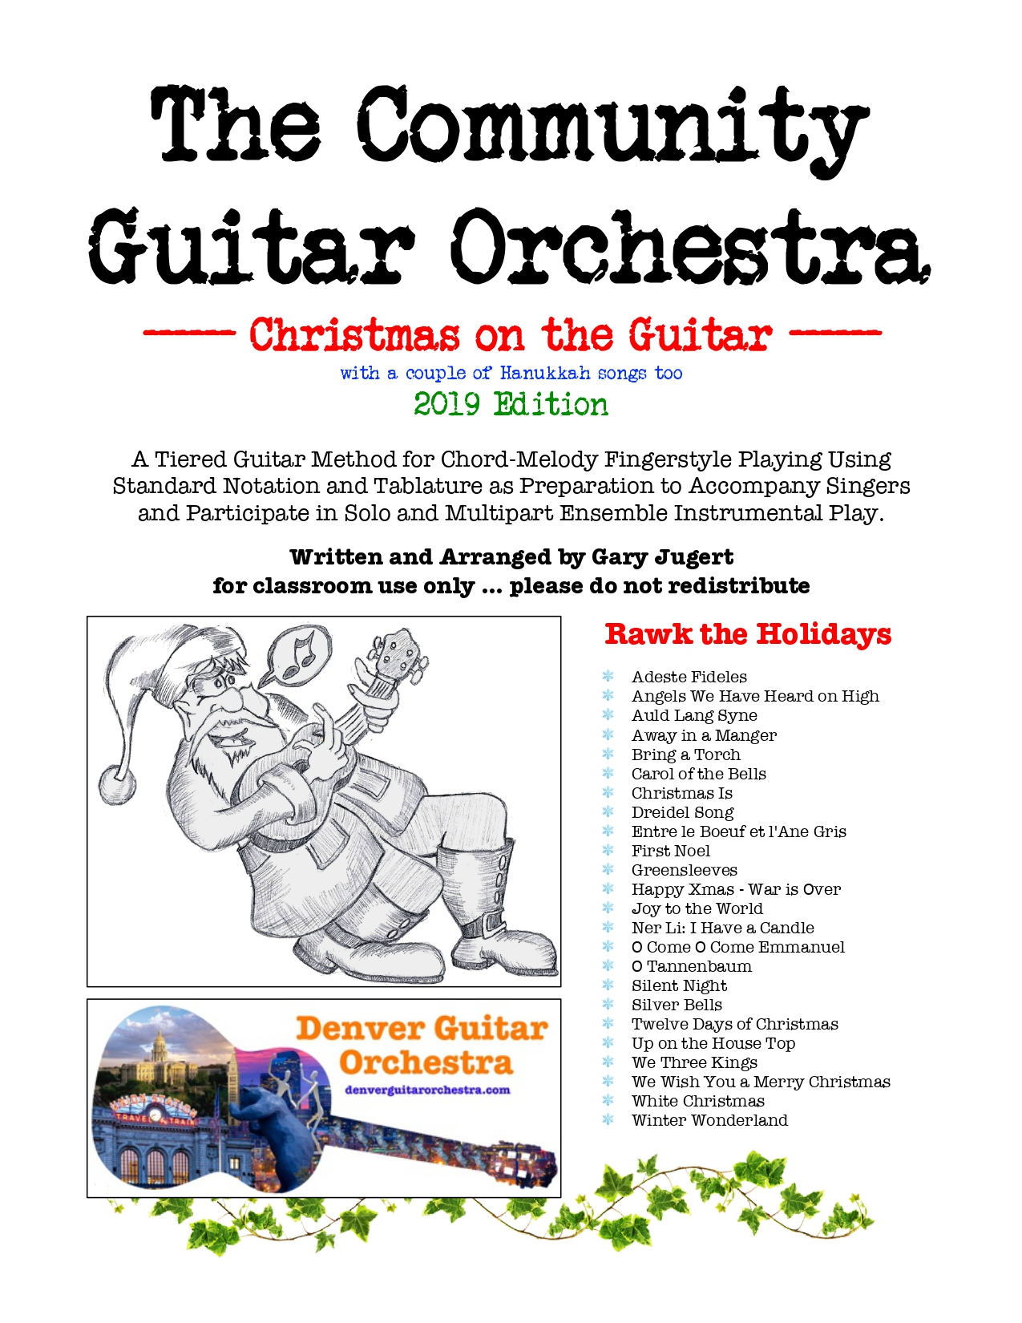
Services Available from RMUO
Graded courses for all levels of ukulele and guitar.

Slide 10
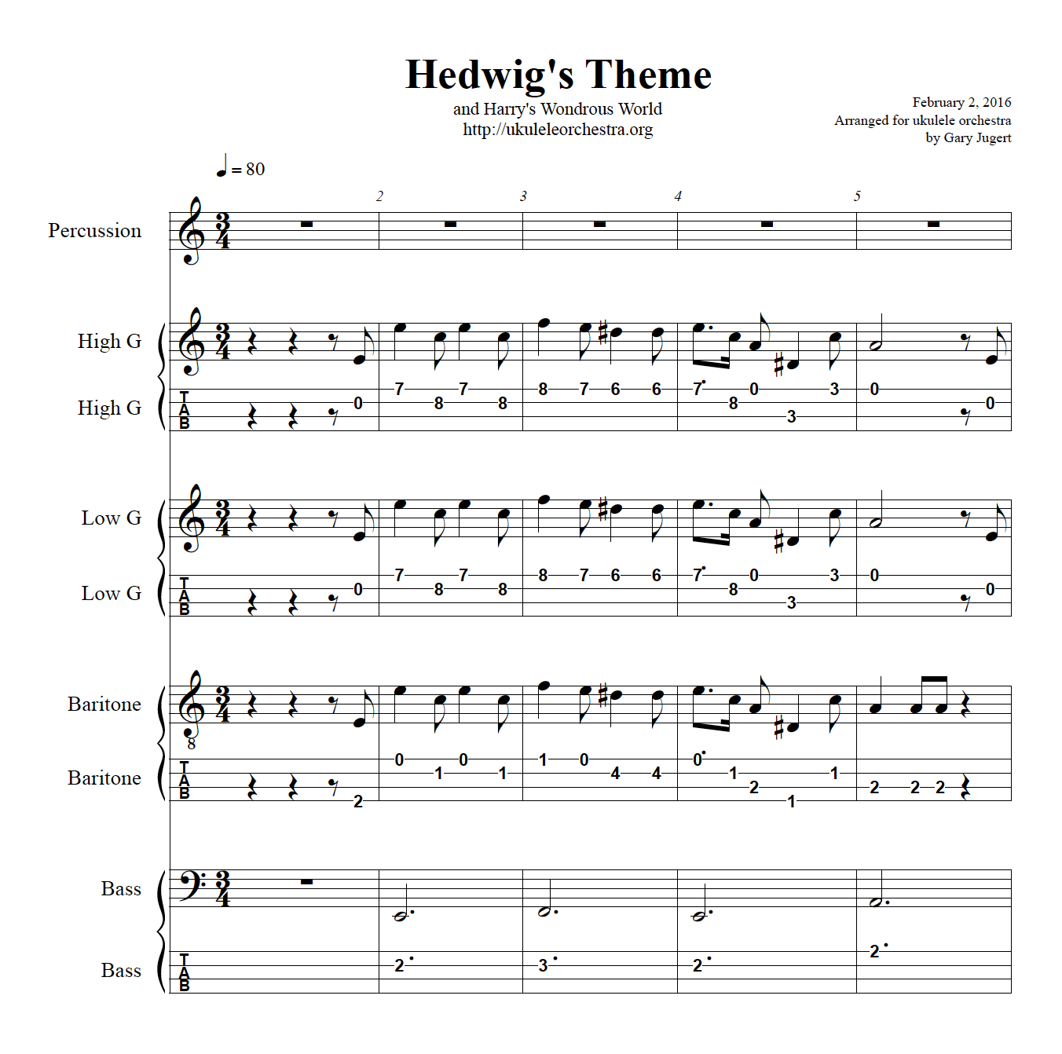
Services Available from RMUO
Sheet music for solo and multipart presentations.
Use what we have and we write new stuff regularly.

Slide 11
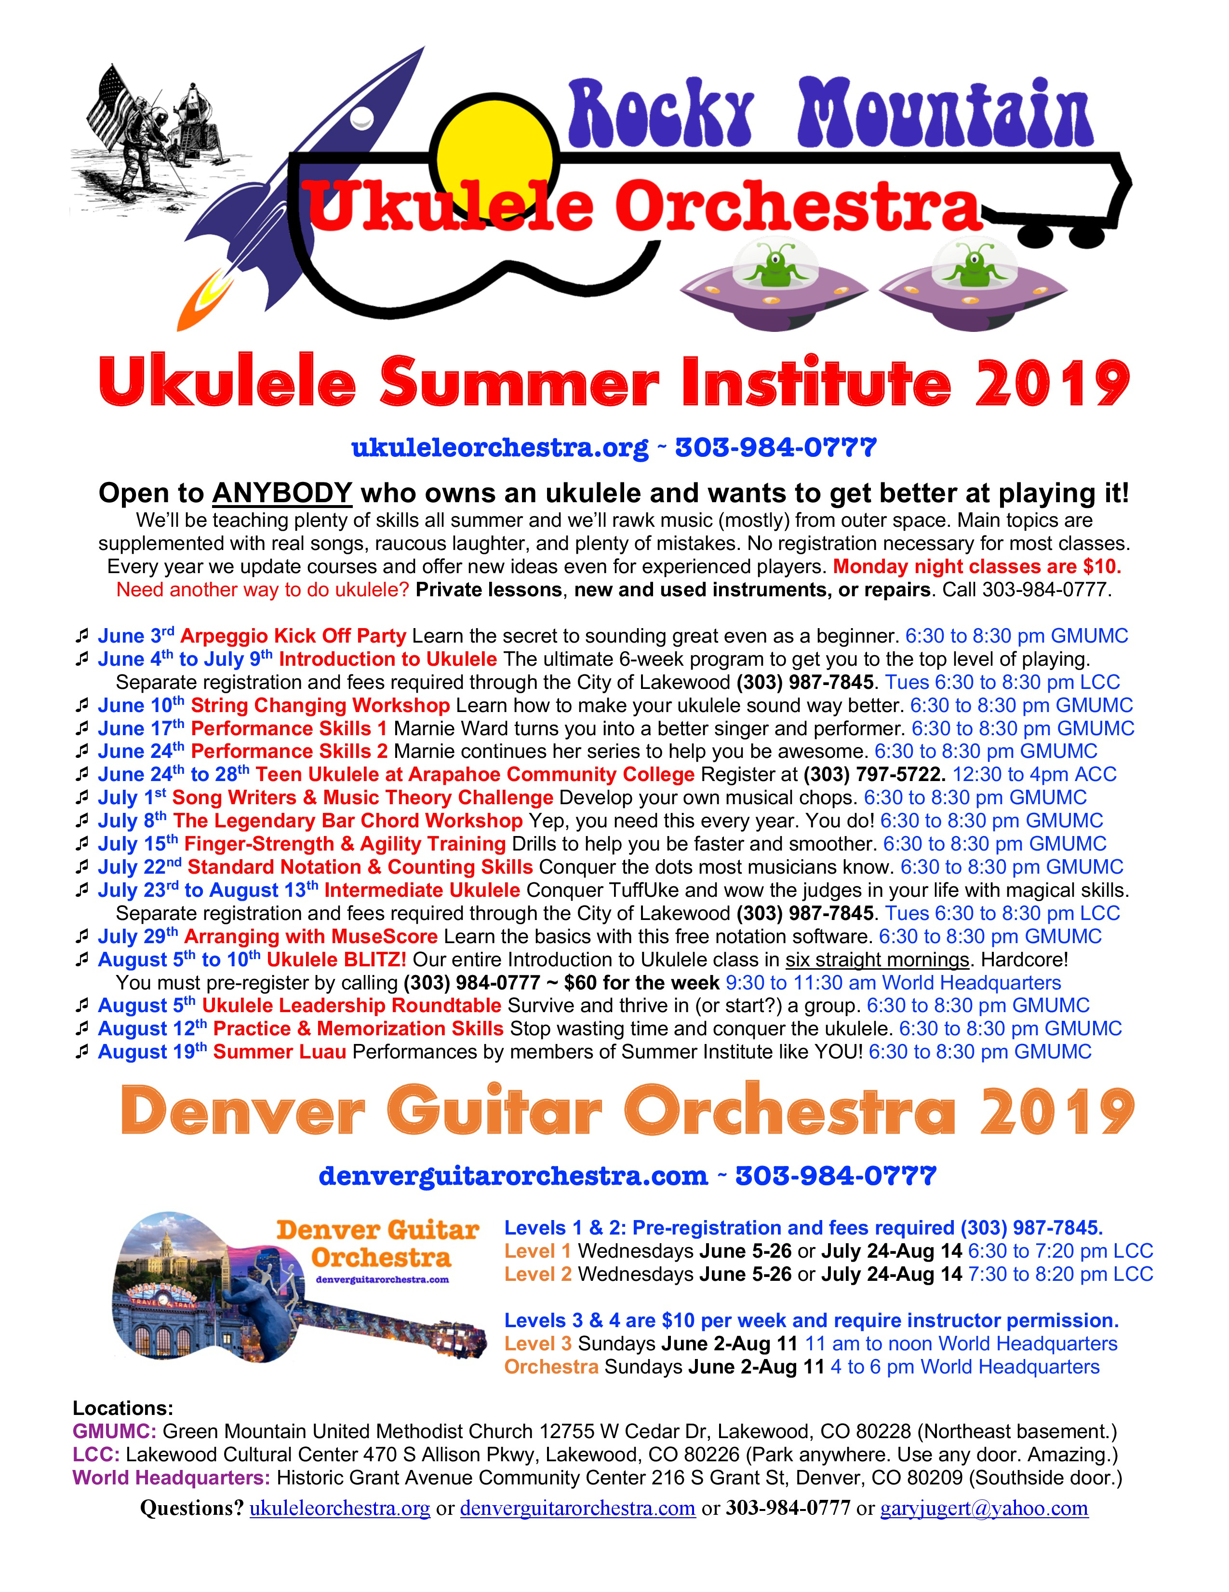
Services Available from RMUO
On-going professional development every summer.

Slide 12
Contact Us
On Google: Rocky Mountain Ukulele Orchestra
Gary Jugert: 303-984-0777 (text is fine)
Sister Organization: Denver Guitar Orchestra
Let’s Make Music

